Slide 1
Online Banking
Digital Banking On FingerTips

Slide 2
TEAM INFORMATION
TEAM MEMBERS:
Meenal Uphale(Mentor)
Prasanth Myla(TEAM LEADER)-
Admin Module
Varthe Ramkrishna Naik-
Login Module
M Mallikharjuna Gari Rameshbabu-
Account Module
Divya Matta-
Payee Module
Trupti Chavan-
Transfer Module

Slide 3
PROBLEM STATEMENT
Every time the user needs to perform some transaction they have to go to bank and perform the necessary actions, which may not be so feasible all the time. Here, we provide an automation for banking system through Internet. The aim is not only automation but also a better customer experience by providing a User Interface which is easily comprehendible by any person.

Slide 4
OBJECTIVES
Automation of banking system
Better customer experience by providing a user interface which is easily comprehendible by user

Slide 5
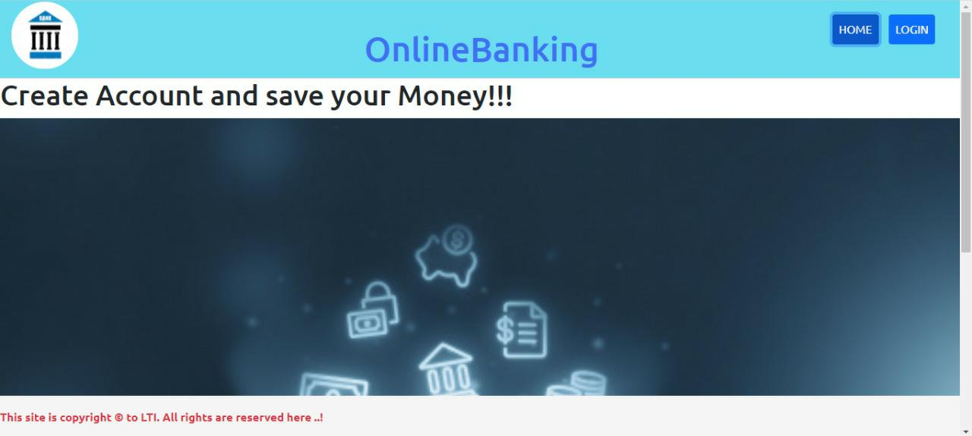
GLIMPSE OF THE PROJECT

Slide 6
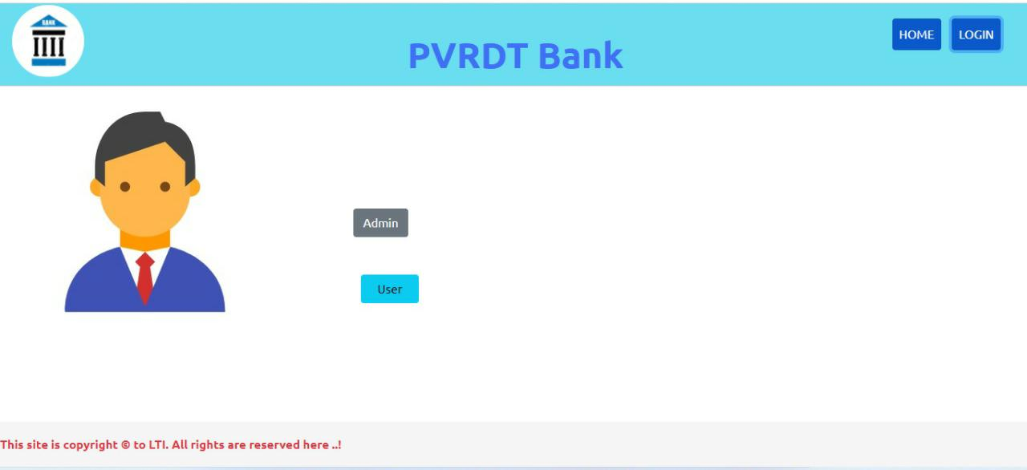

Slide 7
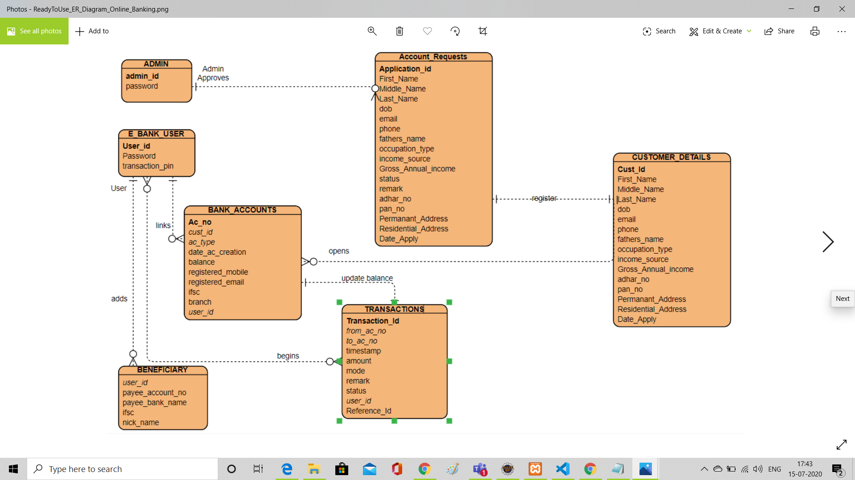
ER Diagram

Slide 8
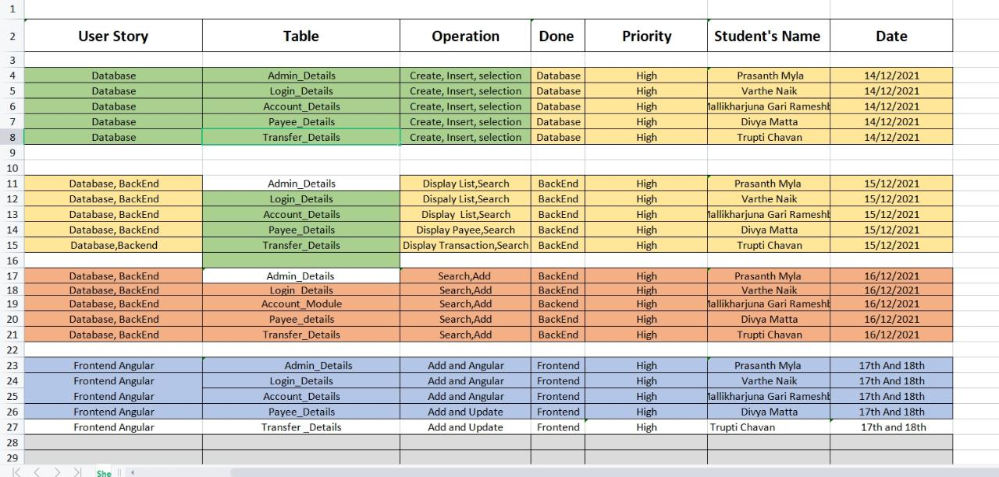
SCRUM TABLE

Slide 9
CONCLUSION
The project will enable users to use banking services like add login, add account, display all transaction list, add transaction and update transaction without need to visit the bank.

